Slide 1
PROBABILITY DISTRIBUTIONS
Samuel.D [Assistant Prof/Epidemiology & Biostatistics; PhD Fellow]

Slide 2
Introduction
Probability is the language of chance.
The deliberate use of chance is the central idea of statistical designs for producing data.
Probability theory was developed out of attempting to solve problems related to games of chance such as tossing a coin, rolling a die etc.

Slide 3
Definition of basic terms
Experiment: is any process or activity that produces a well-defined outcome.
Outcome: is a possible result of an experiment.
Sample space: is the set of all possible outcomes of an experiment.
Event: is a subset of the sample space. It consists of one or more outcomes.

Slide 4
Basic probability concepts
1. Frequentist definition of Probability
The probability that something occurs is the proportion of times it occurs when exactly the same experiment is repeated a very large (preferably infinite!) number of times in independent trials (“independent” means the outcome of one trial of the experiment doesn’t affect any other outcome).

Slide 5

2. Classical Probability
If an event can occur in N mutually exclusive and equally likely ways and if m of these possess a trait, E, the probability of the occurrence of E is equal to m/N.
If we read P(E) as “The probability of E,” we may express this definition as :-

Slide 6
3. Relative Frequency Probability
The relative frequency approach to probability depends on the repeatability of some process and the ability to count the number of repetitions, as well as the number of times that some event of interest occurs.
If some process is repeated a large number of times, N, and if some resulting event with the characteristics E occurs m times, the relative frequency of occurrence of E, m/n, will be approximately equal to the probability of E.

Slide 7
4. Subjective Probability
Assigning probabilities based on the assignor’s judgment.
This view holds that probability measures the confidence that a particular individual has in the truth of a particular proposition.
A number between 0 and 1 that reflects a person’s degree of belief that an event will occur.

Slide 8
Probability in public health & Medicine
Probability plays a crucial role in public health and medicine, helping researchers, clinicians, and policymakers make data-driven decisions and assess risks.

Slide 9
Key areas where probability works
1. Disease Risk Assessment
Probability is used to estimate the likelihood of individuals developing or contracting a disease.
Example: If the probability of developing diabetes in a population is 0.15 (15%), it implies that 15 out of every 100 people are expected to develop the condition.
2. Epidemiological Studies
In cohort and case-control studies, probability helps determine associations between exposures (like smoking) and health outcomes (like lung cancer) such as RR & OR.

Slide 10
3. Diagnostic Testing
Probability concepts help assess the performance of medical tests:
Sensitivity
Specificity
Positive Predictive Value (PPV
Negative Predictive Value (NPV
4. Screening Programs
Probability helps public health professionals decide whether to implement screening programs by calculating the chances of false positives, false negatives, and overall program effectiveness.

Slide 11
Basic properties and rule of probability
Elementary Properties of Probability
1. Given some process (or experiment) with n mutually exclusive outcomes (called events), E₁, E₂,. . . E_{n} the probability of any event E1 is assigned a nonnegative number.
That is, P(E_{i})>0
2. The sum of the probabilities of the mutually exclusive outcomes is equal to 1.
P(E₁)+ P(E₂)+ P(E₃)+........... P(E_{n})=1
3. Consider any two mutually exclusive events, E_{i}, and E_{j}, The probability of the occurrence of either E_{i} or E_{j} is equal to the sum of their individual probabilities.
P(E_{i}+ E_{j})= P(E_{i})+ P(E_{j})

Slide 12
The additive law of Probability
When applied to two mutually exclusive events, states that the probability of either of the two events occurring is obtained by adding the probabilities of each event.
Thus, if A and B are mutually exclusive events,
Pr(A or B) = Pr(A)+Pr(B)
Pr(A or B) is also termed as Pr(AuB)

Slide 13
Eg.
One dice is rolled. Sample space = S = (1,2,3,4,5,6)
Let A = the event an odd number turns up, A=(1,3,5)
Let B = the event a 1,2 or 3 turns up; B=(1,2,3 )
Let C = the event a 2 turns up, C= (2)
i) Find Pr (A); Pr (B) and Pr (C)
Pr(A) = Pr(1) + Pr(3) + Pr(5) = 1/6+1/6+1/6 =3/6 = ½
Pr(B) = Pr(1) + pr(2) + Pr(3) = 1/6+1/6+1/6 =3/6 = ½
Pr ( C ) = Pr(2) = 1/6

Slide 14
ii) Are A and B; A and C; B and C mutually exclusive?
A and B are not mutually exclusive. Because they have the elements 1 and 3 in common.
Similarly, B and C are not mutually exclusive. They have the element 2 in common.
A and C are mutually exclusive. They don’t have any element in common.
When A and B are not mutually exclusive pr(A or B) = Pr(A) + Pr(B) cannot be used. The reason is that in such a situation A and B overlap in a venn diagram, and the elements in the overlap are counted twice.

Slide 15
Therefore, when A and B are not mutually exclusive, Pr(A or B) or Pr(AuB)= Pr (A) + Pr(B) – Pr(A and B).
Pr(A and B) is also stated as Pr(A∩B)
The formula considered earlier for mutually exclusive events is a special case of this, since pr(A∩B) = 0.

Slide 16
Eg.
Of 200 seniors at a certain college, 98 are women, 34 are majoring in Biology, and 20 Biology majors are women.
If one student is chosen at random from the senior class, what is the probability that the choice will be either a Biology major or a women).

Slide 17
Given:-
Pr(women)= 34/200
Pr(Biology Major)= 34/200
Pr(Biology major and woman)= 20/200
Pr(Biology or Woman)= ?
Pr (Biology major or woman) = Pr(Biology major) + Pr(woman)–Pr(Biology major and woman) =34/200 + 98/200 - 20/200 = 112/200 =0.56

Slide 18

The birth of a son or a daughter are mutually exclusive because the two events will not happen at the same time.
The birth of daughter and the birth of a carrier of the sickle-cell anemia allele are not mutually exclusive because the two events can happen at the same time (they are independent events)

Slide 19
Conditional probabilities and the multiplicative law
Sometimes the chance a particular event happens depends on the outcome of some other event. This applies obviously with many events that are spread out in time.
Eg. The chance a patient with some disease survives the next year depends on his having survived to the present time. Such probabilities are called conditional.
The notation is Pr(B/A), which is read as “the probability event B occurs given that event A has already occurred.”

Slide 20
Let A and B be two events of a sample space S. The conditional probability of an event A, given B, denoted by Pr (A/B )= Pr(A n B) / Pr(B) , Pr(B) ≠ 0.
Similarly, Pr(B/A) = Pr(A n B) / Pr(A) , Pr(A) ≠ 0. This can be taken as an alternative form of the multiplicative law.

Slide 21
Independent Events
Often there are two events such that the occurrence or nonoccurrence of one does not in any way affect the occurrence or nonoccurrence of the other.
This defines independent events.
Thus, if events A and B are independent, Pr(B/A) = P(B); Pr(A/B) = P(A).

Slide 22
Eg
A classic example is n tosses of a coin and the chances that on each toss it lands heads. These are independent events. The chance of heads on any one toss is independent of the number of previous heads. No matter how many heads have already been observed, the chance of heads on the next toss is ½.
A similar situation prevails with the sex of offspring. The chance of a male is approximately ½. Regardless of the sexes of previous offspring, the chance the next child is a male is still ½.

Slide 23
If two events are independent,
Pr(AnB)= Pr(A)xPr(B).
Hence,
Pr(A) = Pr(A and B) / Pr(B) , where Pr(B) ≠ 0
Pr(B) = Pr(A and B) / Pr(A) , where Pr(A) ≠ 0

Slide 24
Joint probability
refers to the probability of two or more events occurring together.
It is denoted as P(A∩B), which reads "the probability of both events A and B occurring simultaneously.“
Formula for Joint Probability
If Events A and B are Independent:
P(AnB) = P(A) * P(B)
If Events A and B are Dependent:
P(AnB) = P(A) * P(B/A)

Slide 25
Normal Probability Distribution
The following are some important characteristics of the normal distribution.
It is symmetrical about its mean, μ. (The curve on either side of μ is a mirror image of the other side.
The mean, the median, and the mode are all equal.
The total area under the curve above the x-axis is one square unit.

Slide 26
Characteristics cont…
4. If we erect perpendiculars a distance of 1 standard deviation from the mean in both directions, the area enclosed by these perpendiculars, the x-axis, and the curve will be approximately 68 percent of the total area.
If we extend these lateral boundaries a distance of two standard deviations on either side of the mean, approximately 95 percent of the area will be enclosed, and
Extending them a distance of three standard deviations will cause approximately 99.7 percent of the total area to be enclosed.

Slide 27
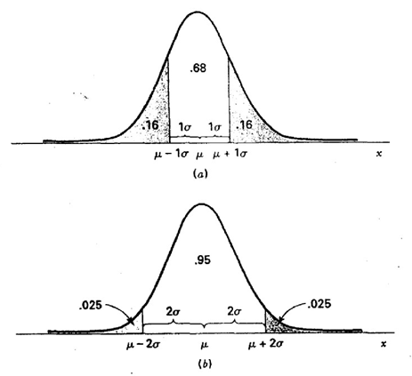
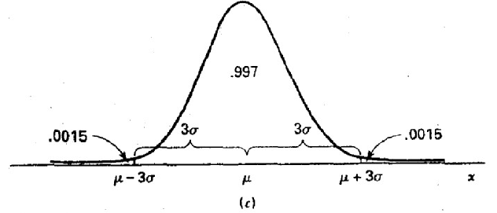

Slide 28
Binomial Distribution
Definition
is a discrete probability distribution that models the number of successes in a fixed number of independent Bernoulli trials, where each trial has only two possible outcomes: success or failure.
Characteristics
Fixed number of trials: n
Two possible outcomes: Success (with probability p) or Failure (with probability 1−p)
Trials are independent: The outcome of one trial does not affect the others.
Probability of success (p) is the same for each trial.

Slide 29
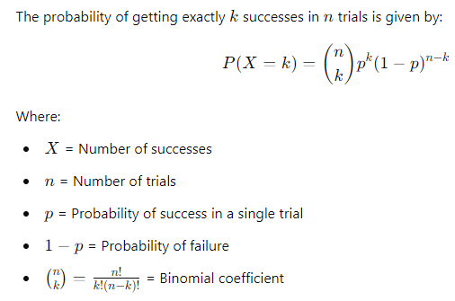

Slide 30
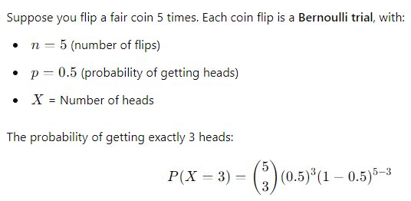
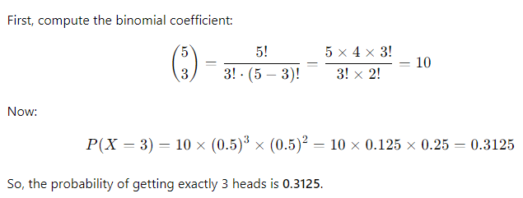
Example

Slide 31
Poisson distribution
Definition
is a discrete probability distribution that models the number of times an event occurs in a fixed interval of time, space, or other continuous domain, given that the events occur independently and with a constant average rate.
Characteristics
Events occur independently: One event does not influence another.
Constant rate (λ): The average number of occurrences per unit time/space.
The probability of two or more events happening simultaneously is negligible.
The number of occurrences is discrete: It can only take non-negative integer values (0, 1, 2, …).

Slide 32
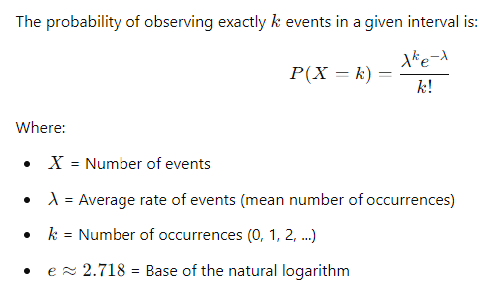

Slide 33
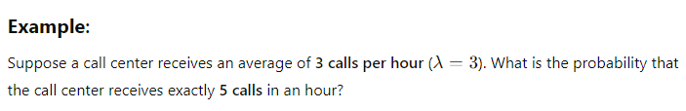
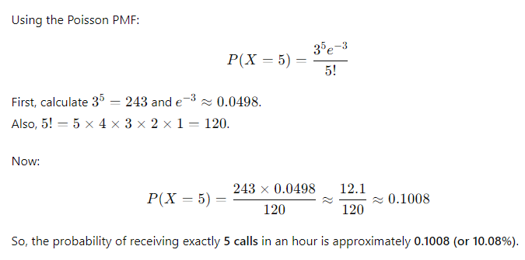

Slide 34
Thank You!!

